Slide 1
Dynamic Programming & Greedy Technique

Slide 2
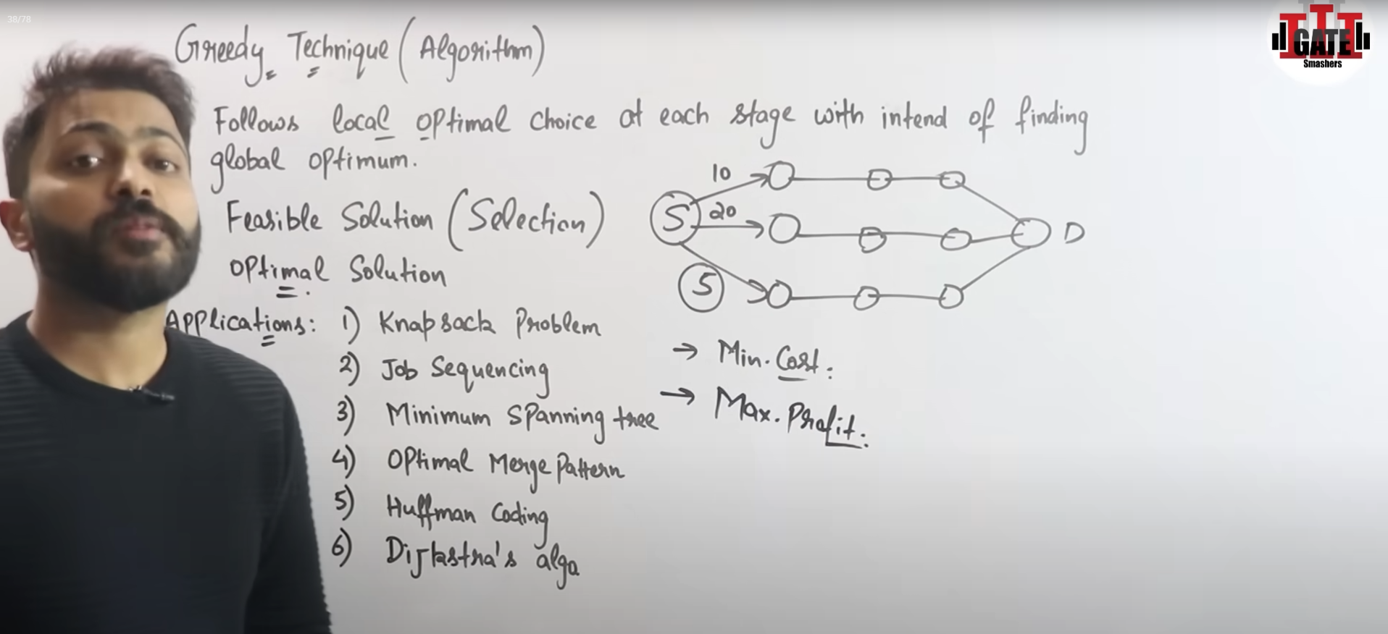

Slide 3
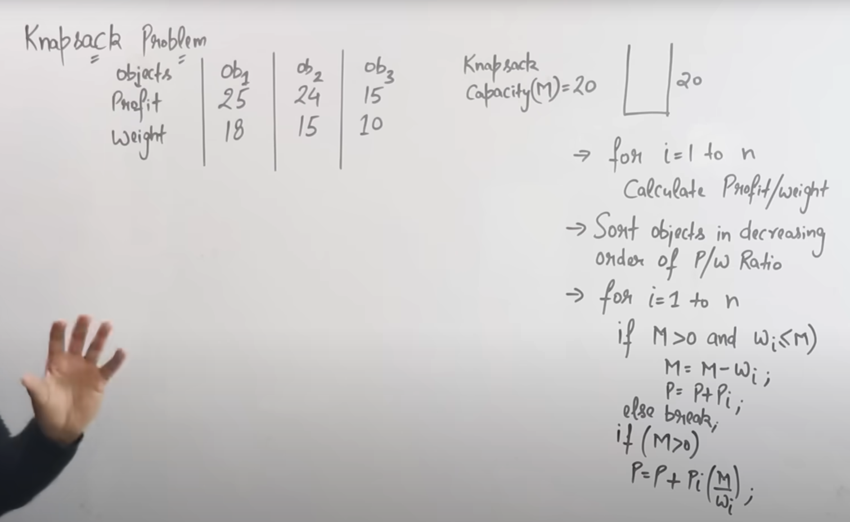
Knapsack Problem using Greedy Technique
Types of Knapsack
a. 0/1 Knapsack → Either take an item completely or leave it. ❌ Greedy does not guarantee the best solution here.
b. Fractional Knapsack → You can take fractions of items. ✅ Greedy works perfectly here.

Slide 4
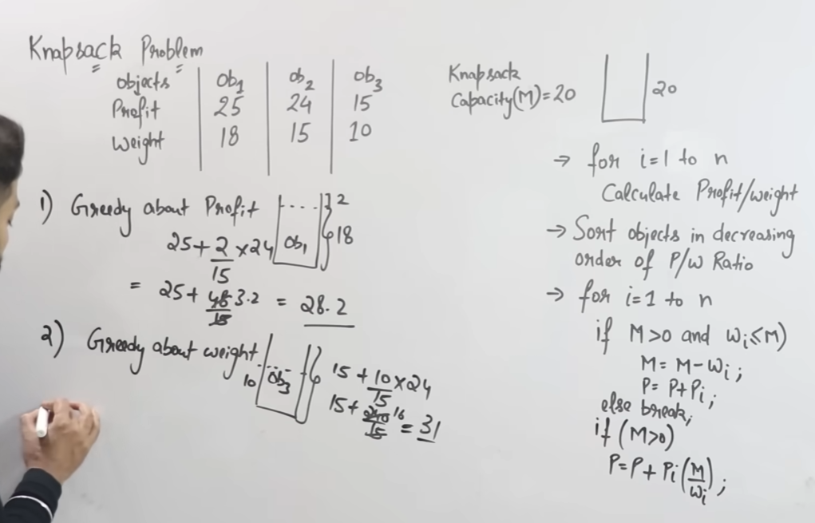
Greedy Approach for Fractional Knapsack:
Greedy about Profit or Weight

Slide 5
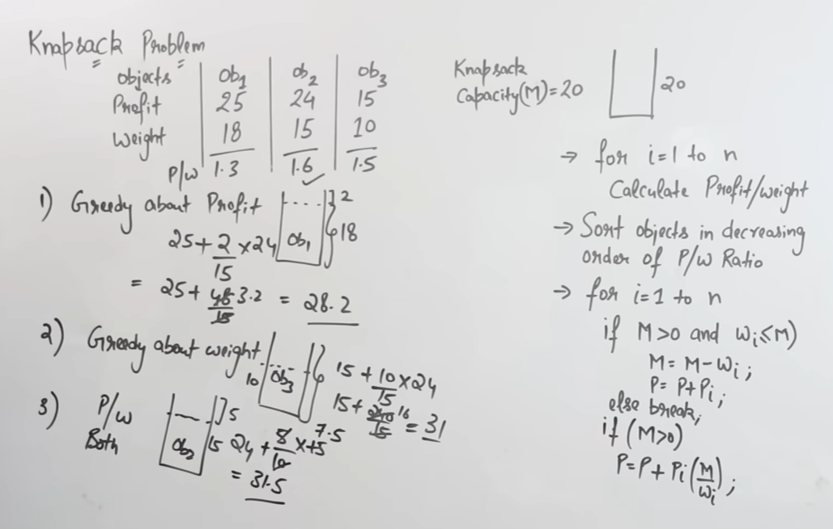
Optimal Solution: Greedy about both profit and weight

Slide 6
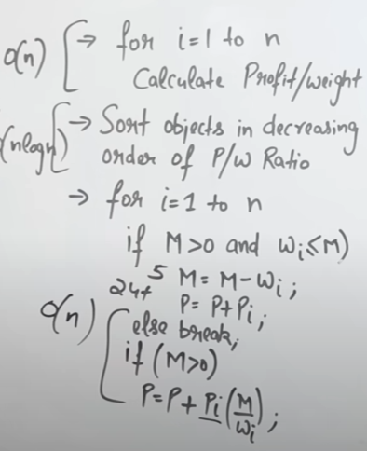
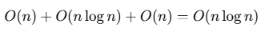
Steps & Time Complexity:
Compute value/weight ratio for all items
Takes O(n) (where n = number of items).
Sort items by ratio in descending order
Sorting costs O(n log n).
Iterate over items and fill knapsack
Takes O(n).
Total Time Complexity:
Space Complexity
We only store ratios and a few variables → O(n).

Slide 7
Huffman Coding
We are given characters with their frequencies. The goal is to assign variable-length binary codes to characters such that:
More frequent characters get shorter codes.
Less frequent characters get longer codes.
No code is a prefix of another (prefix-free property).
This minimizes the total cost (weighted path length) of encoding.

Slide 8
Huffman Coding using Greedy Approach
1. Create a Min-Heap (priority queue) of all characters based on their frequency.
2. While heap size > 1:
Extract two nodes with smallest frequency.
Create a new internal node with frequency = sum of the two.
Insert the new node back into the heap.
3. The final node left is the root of Huffman Tree.
4. Assign 0 for left edge and 1 for right edge to generate codes.

Slide 9
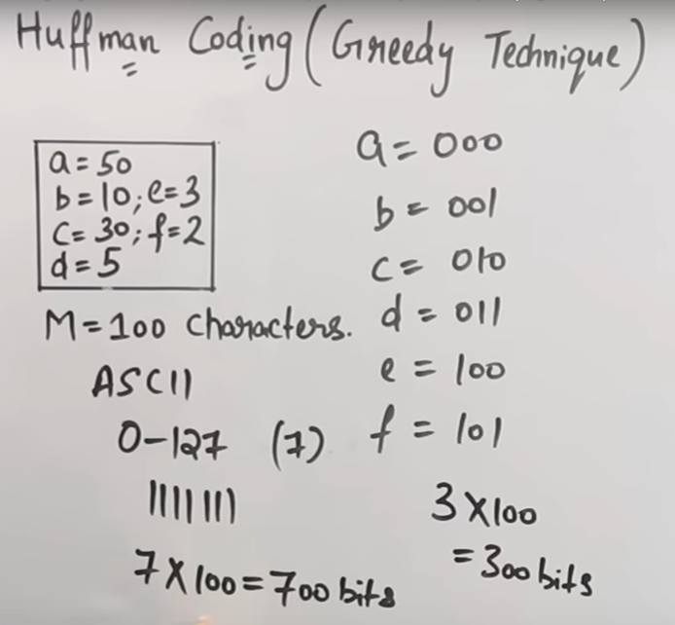
ASCII Encoding
Each character is stored using fixed-length codes.
Standard ASCII → 7 bits (0–127 codes).
Extended ASCII → 8 bits (0–255 codes).

Slide 10
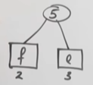
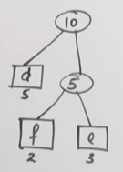
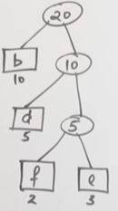
Steps in Huffman Coding(Greedy)
Step 1: Take two minimum alphabets and combine their value
NOTE: keep small on left and big on right
Step 2: Step 3:

Slide 11
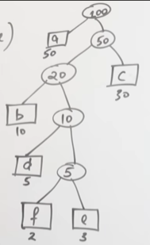
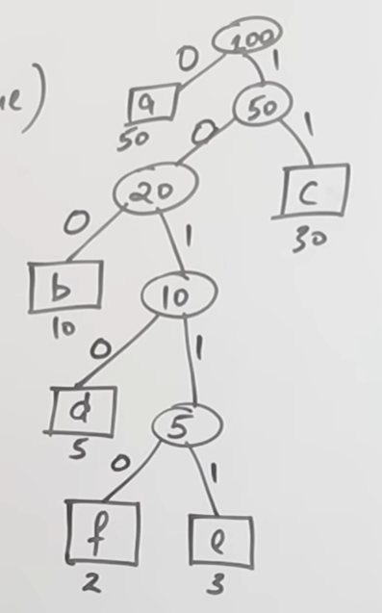
Steps in Huffman Coding(Greedy)
Step 4: Step 5: give edge on left 0 and on right 1 Note: You can take 0 and 1 on right or left also

Slide 12
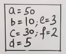
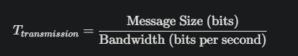
Steps in Huffman Coding(Greedy)
Step 6: Now to represent a how many bit will be required and which coding will be used let’s see
a = 0 -> 50 x 1 = 50 bits
b = 100 -> 10 x 3 = 150 bits
c = 11 -> 30 x 2 = 60 bits
d = 1010 -> 5 x 4 = 20 bits
e = 10111 -> 3 x 5 = 15 bits
f = 10110 -> 2 x 5 = 10 bits
Total = 185 bits will be required to convert this entire message to Huffman encoding
Average bits required to represent each character = 185/100 = 1.85 bits per characters
Transmission Time =>
Transmission Time = 185/ Bw

Slide 13
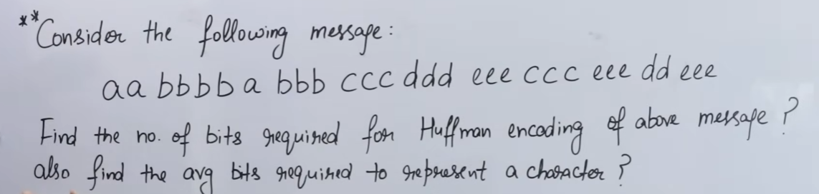
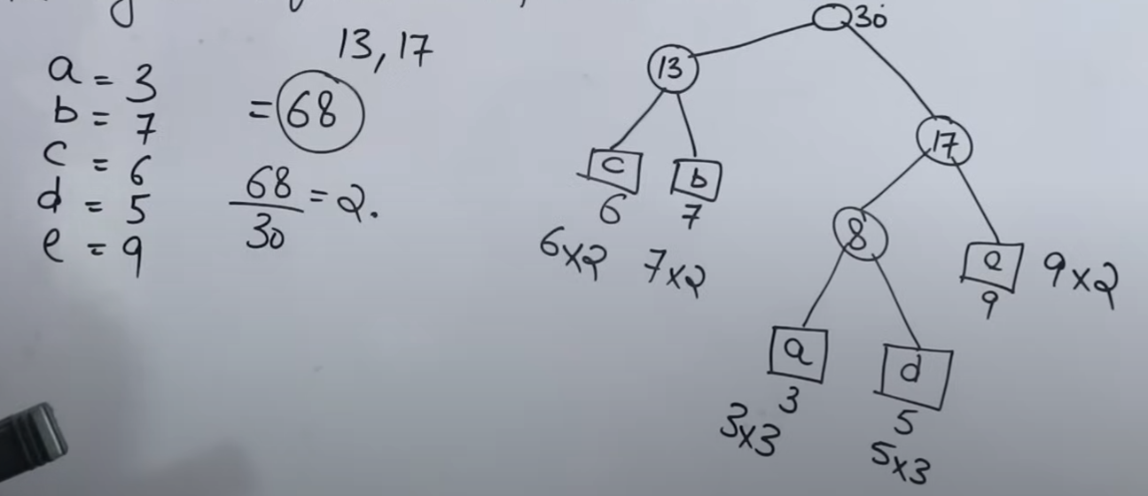
Total Bits = 68
Average Bits = 68 / 30 = 2.26

Slide 14
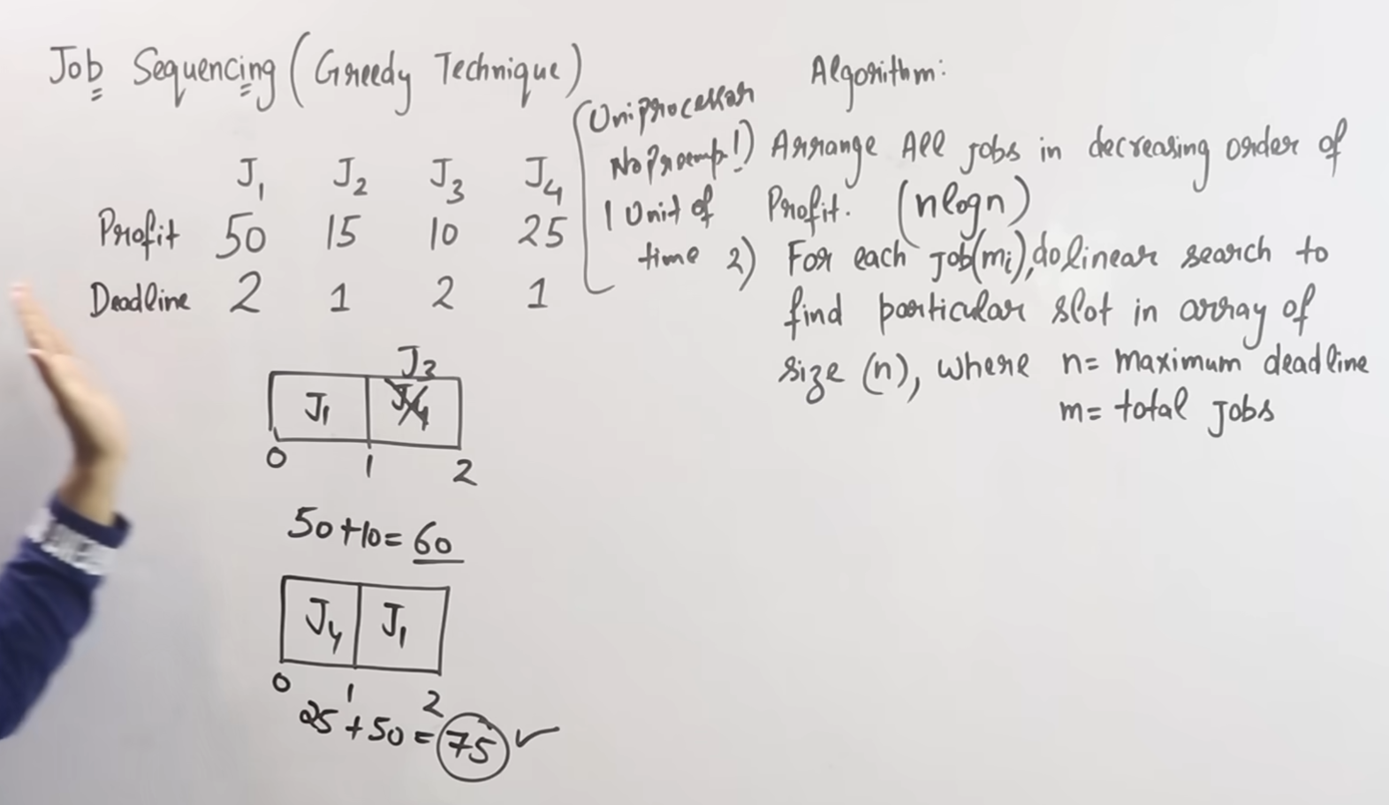

Slide 15
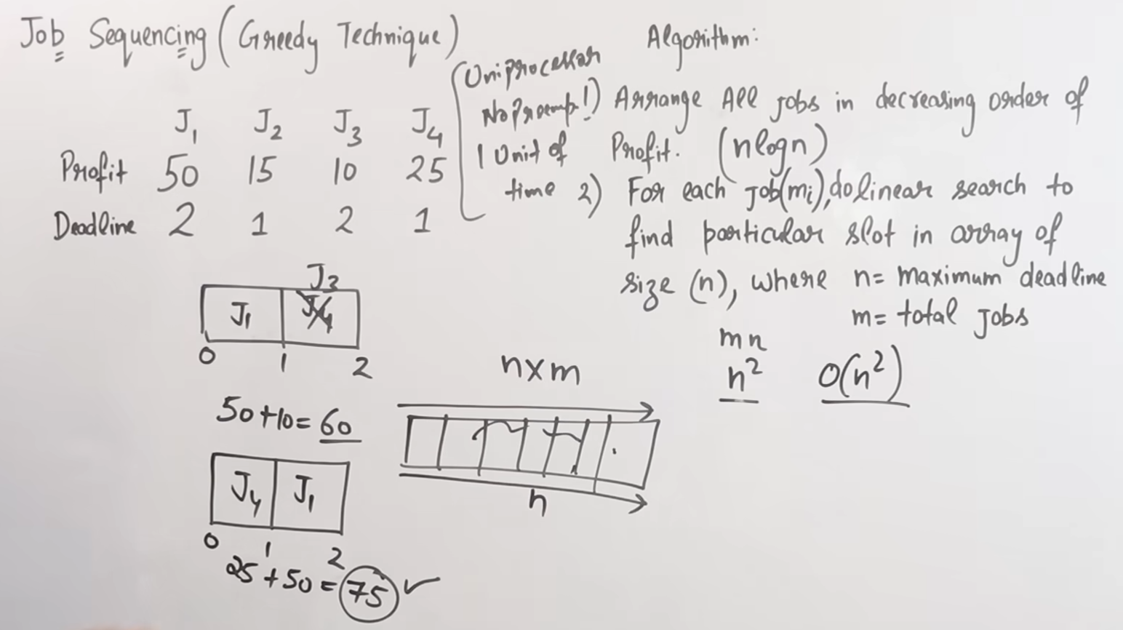

Slide 16
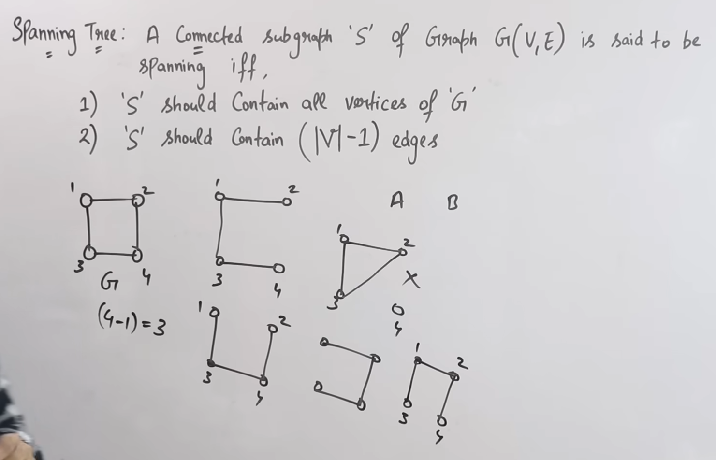
Spanning Tree

Slide 17
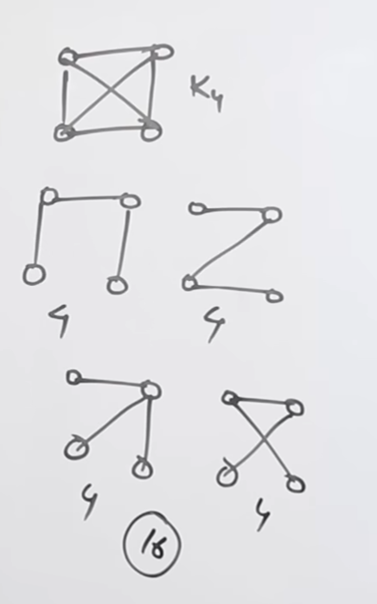
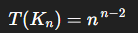
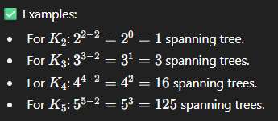
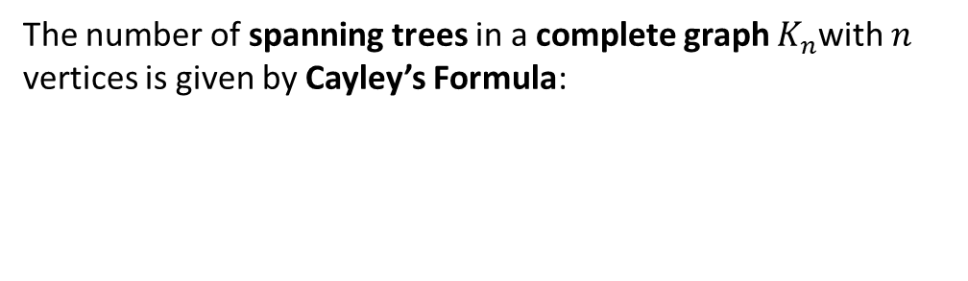
How many spanning tree is possible in a complete graph ?
The number of spanning trees in a complete graph $K_{n}$with $n$ vertices is given by Cayley’s Formula:

Slide 18
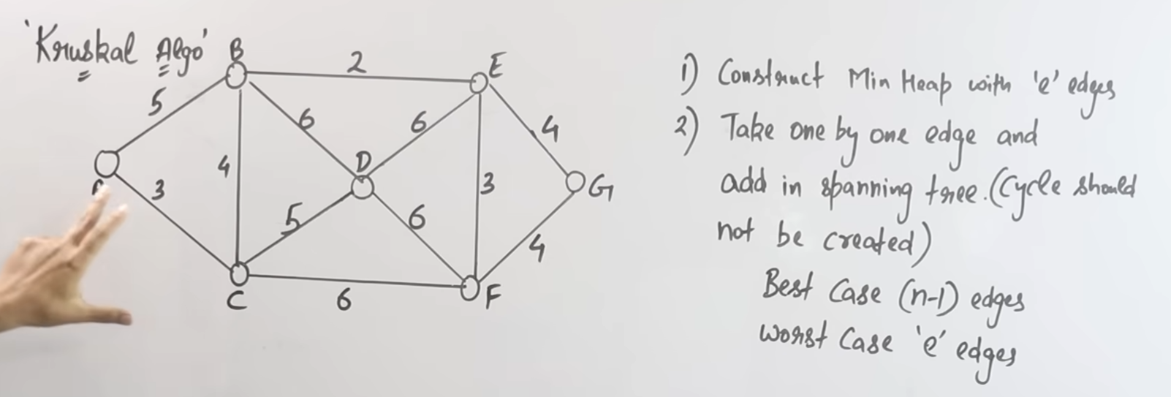
Kruskal’s Algorithm for minimum cost spanning tree

Slide 19
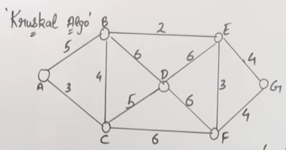
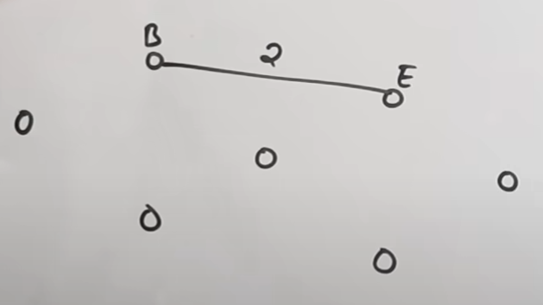
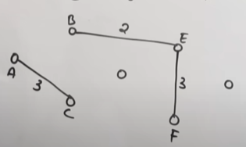
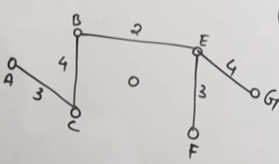
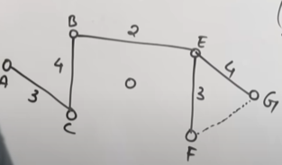
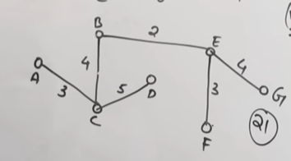
Step: Sort edges by weight and pick edges one by one but don’t take the edge which will form cycle:
-> ->
|
Note: We will not take the edge from F to G although it’s minimum(i.e. 4)
Total Weight = 21

Slide 20
Time Complexity
Sorting edges: O(E log E)
Union-Find operations: almost O(1) (with path compression)
Total: O(E log E)

Slide 21
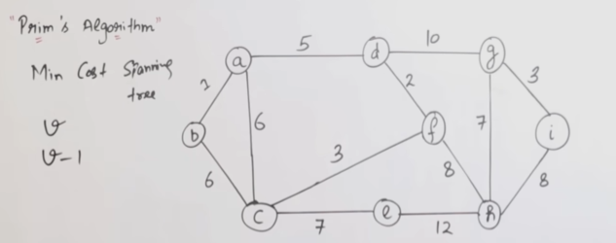
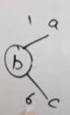
Prim’s Algorithm
Goal: Find a Minimum Spanning Tree (MST) of a connected, undirected, weighted graph.
Key Idea (Greedy choice): At each step, expand the tree by adding the minimum weight edge that connects a vertex inside the tree to a vertex outside the tree.
-> Here we will pick the minimum edge i.e 1 similarly for other edges but will not take the edge that will form a cycle even if it’s minimum

Slide 22
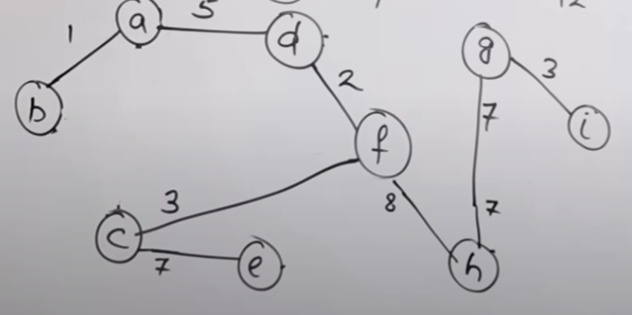
Total Weight / Minimum Cost = 1+5+2+3+7+8+7+3 = 36

Slide 23
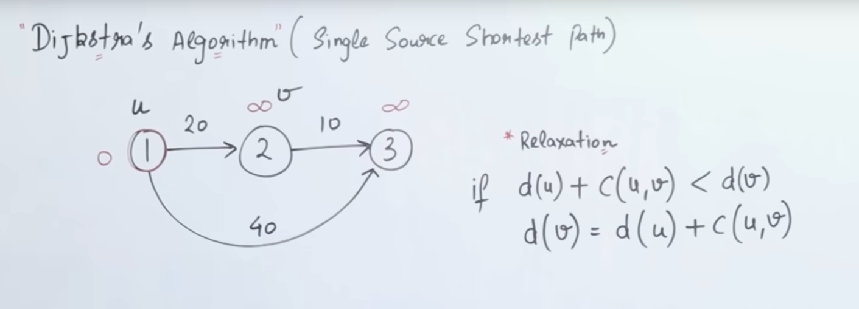
Djkstra’s Algorithm
WORKING:

Slide 24
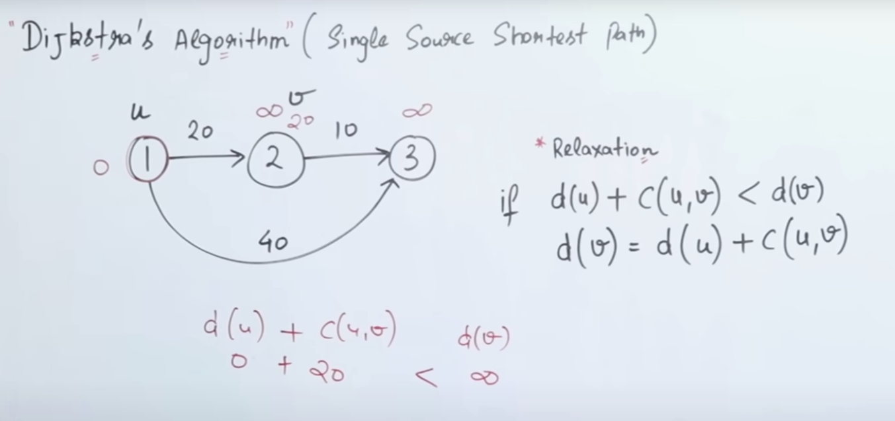
Cost from 1 to 2

Slide 25
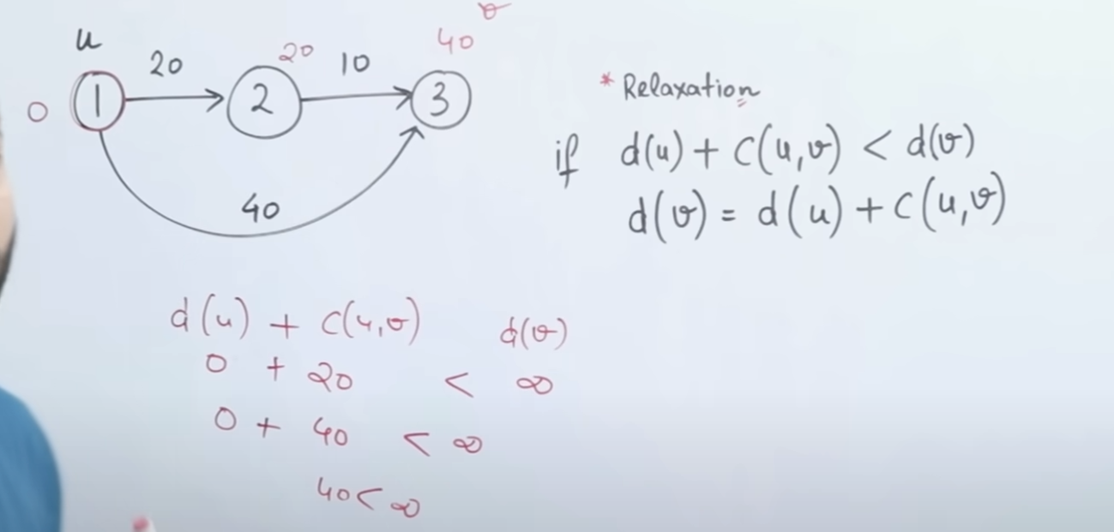
Cost from 1 to 3

Slide 26
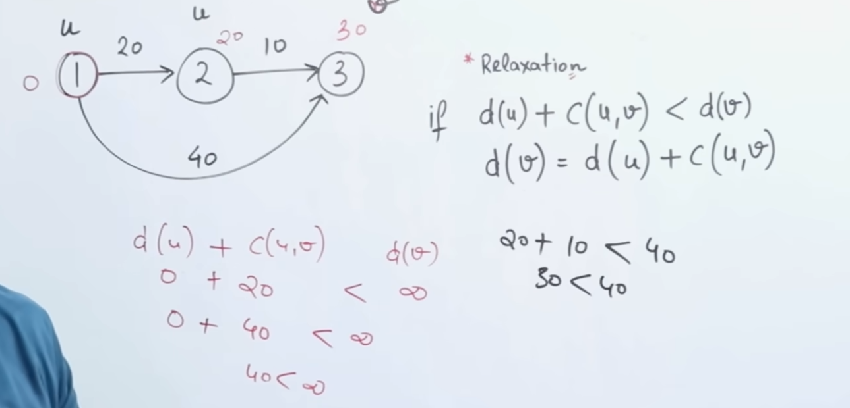
Cost from 2 to 3

Slide 27
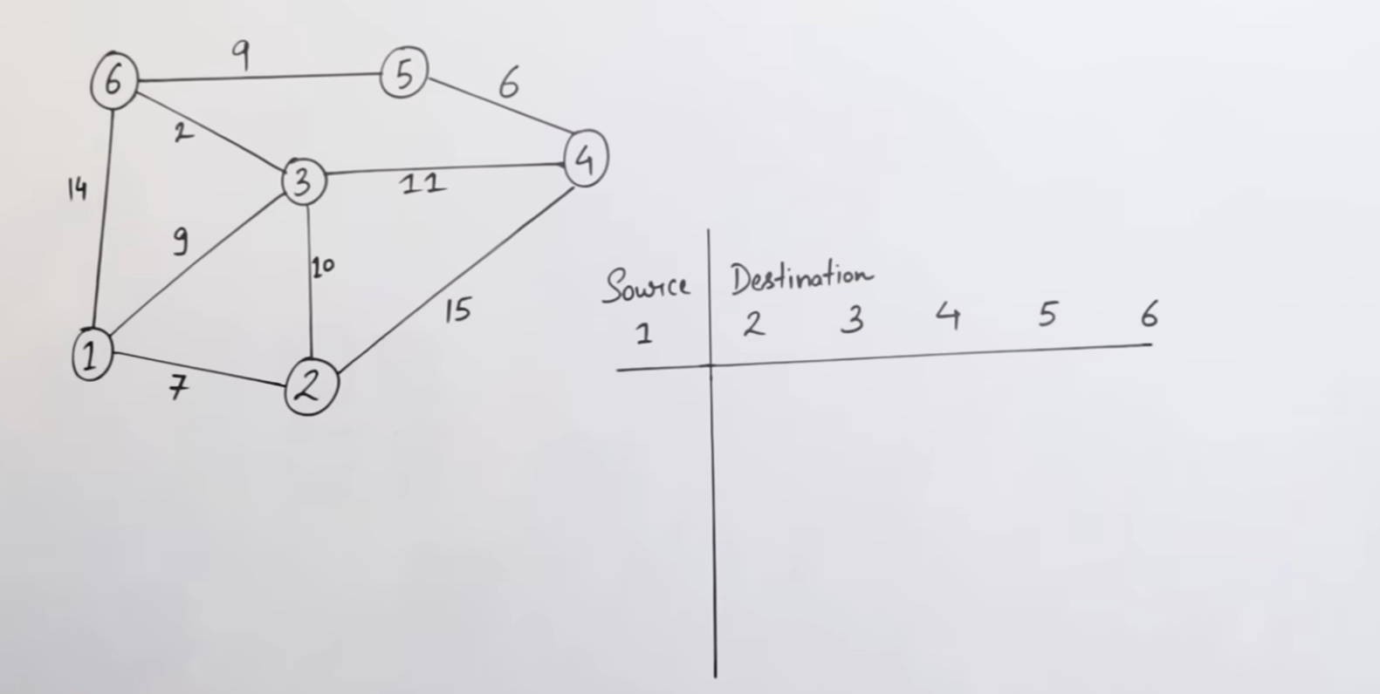
EXAMPLE:

Slide 28
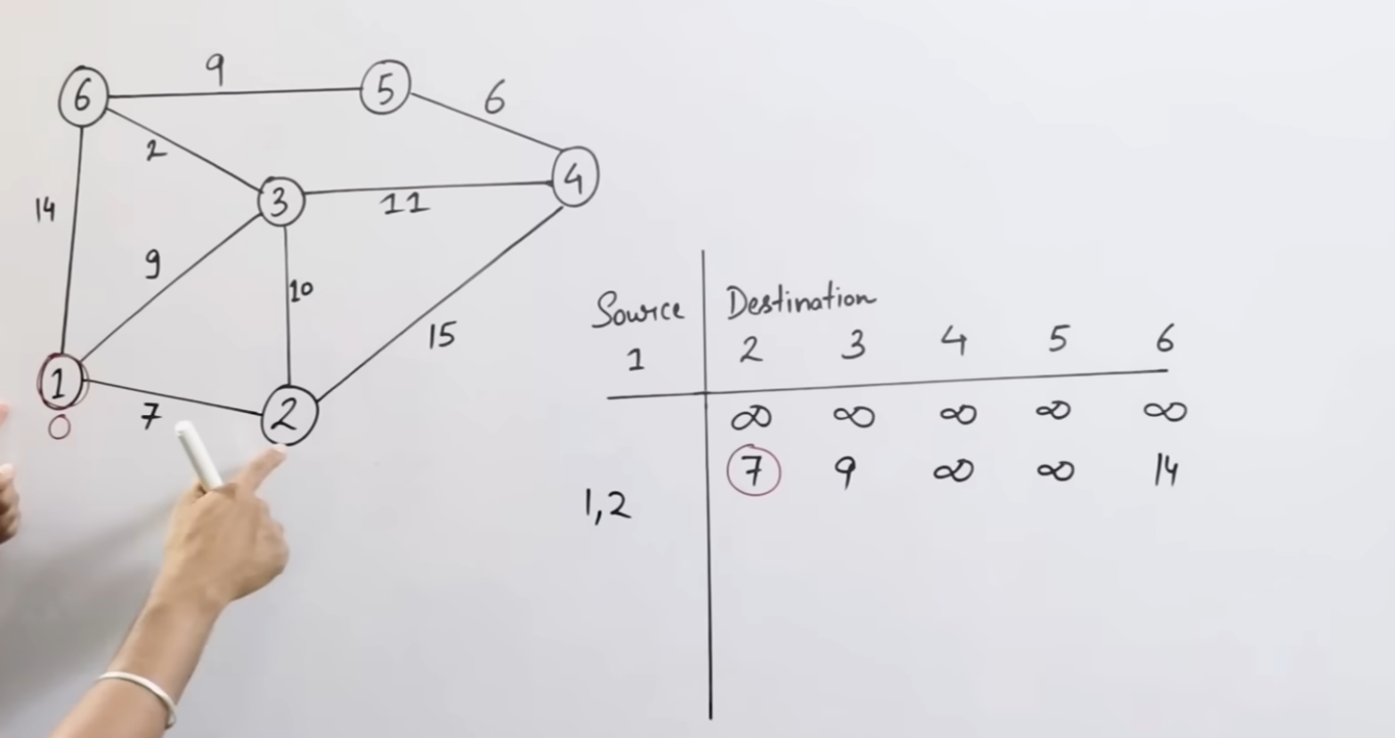

Slide 29
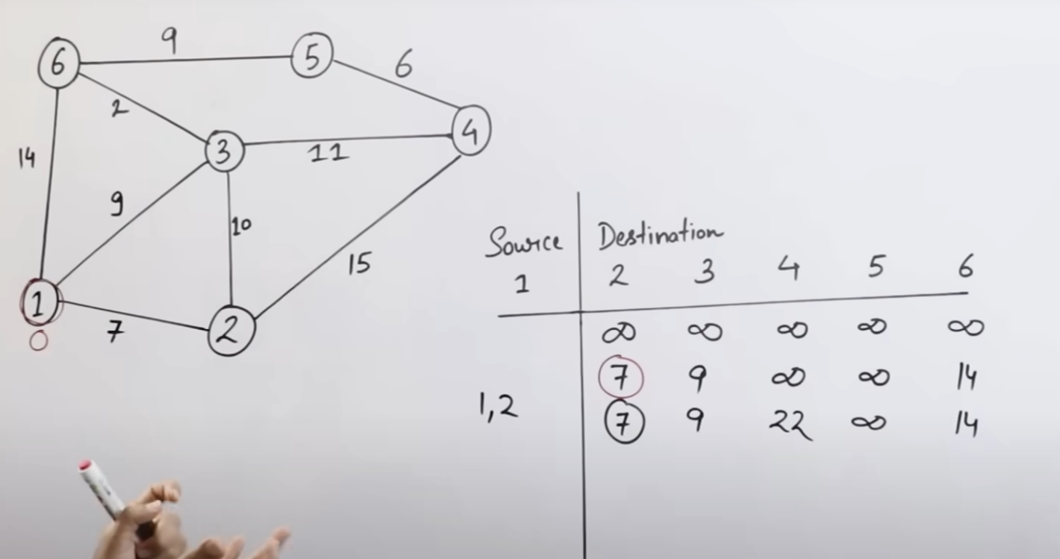
from 1 via 2
2 is relaxed

Slide 30
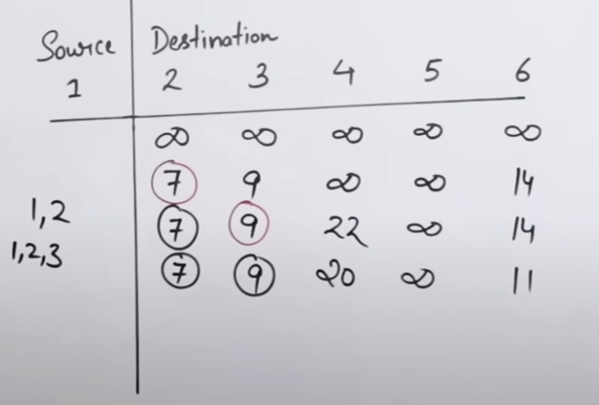
from 1 via 2 or 3
3 is relaxed

Slide 31
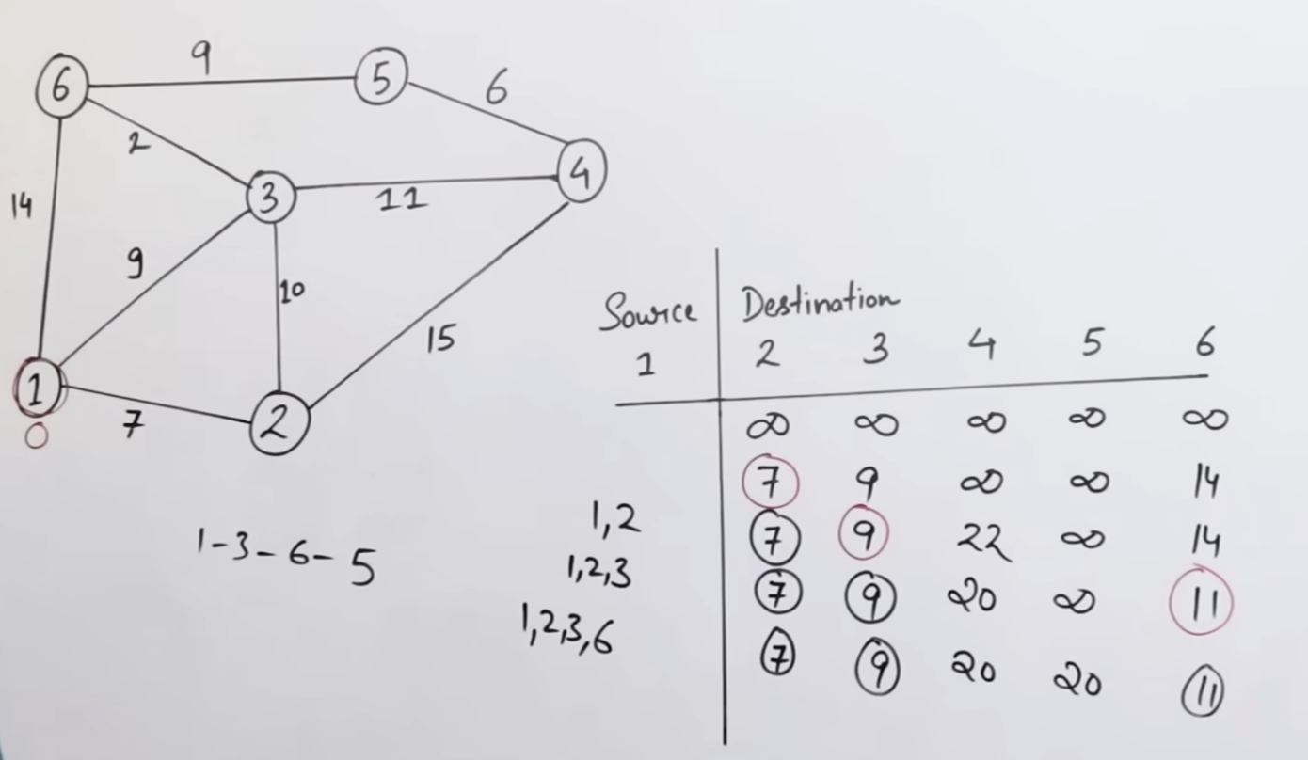

Slide 32
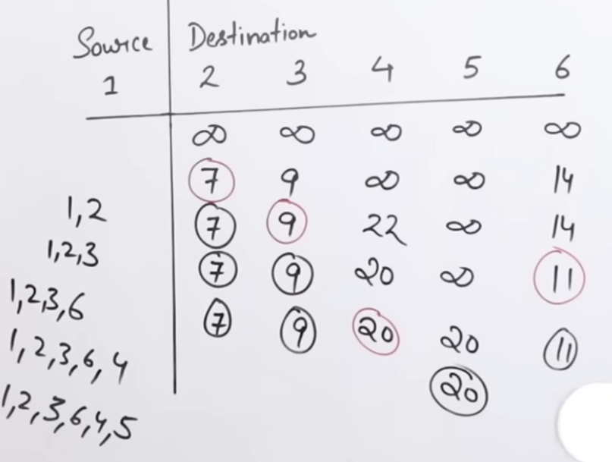
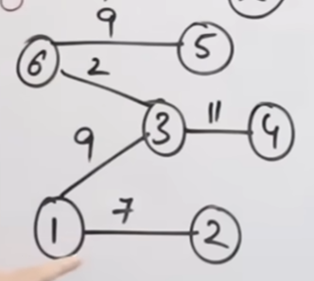
All nodes are relaxed now
Destination | Total Cost | Path
2 | 7 | 1 → 2
3 | 9 | 1 → 3
4 | 20 | 1 → 3 → 4
5 | 20 | 1 → 3 → 6 → 5
6 | 11 | 1 → 3 → 6

Slide 33
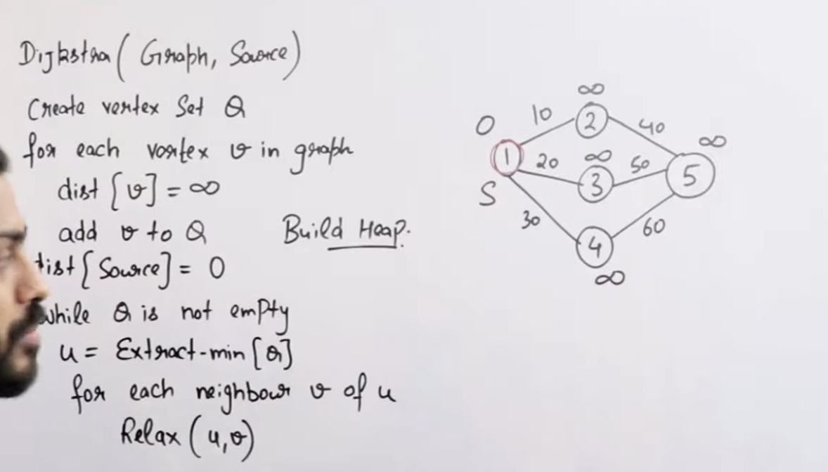

Slide 34
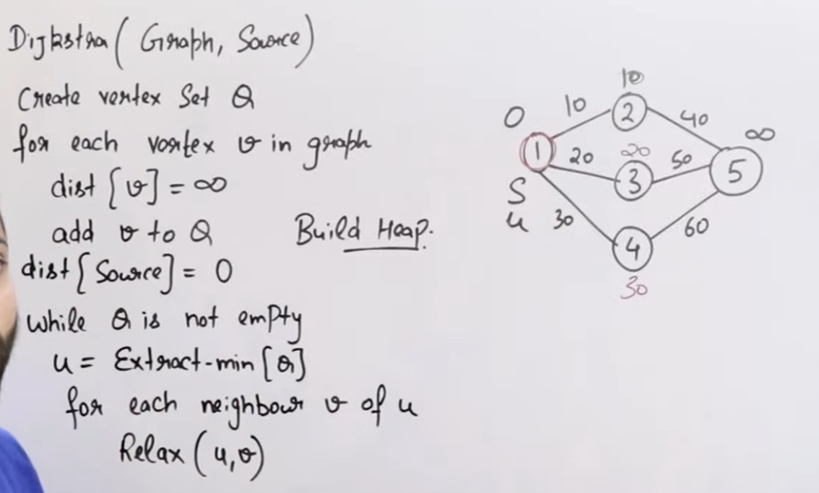
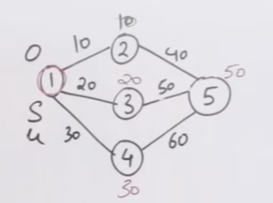

Slide 35
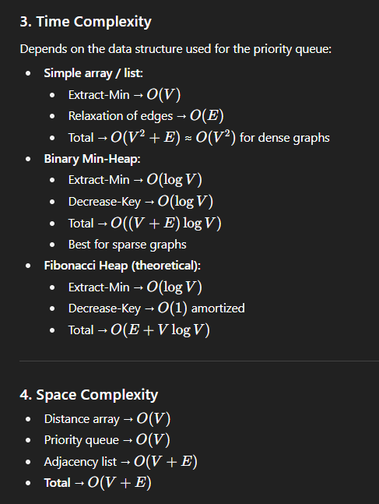
Analysis of Dijkstra’s Algorithm

Slide 36
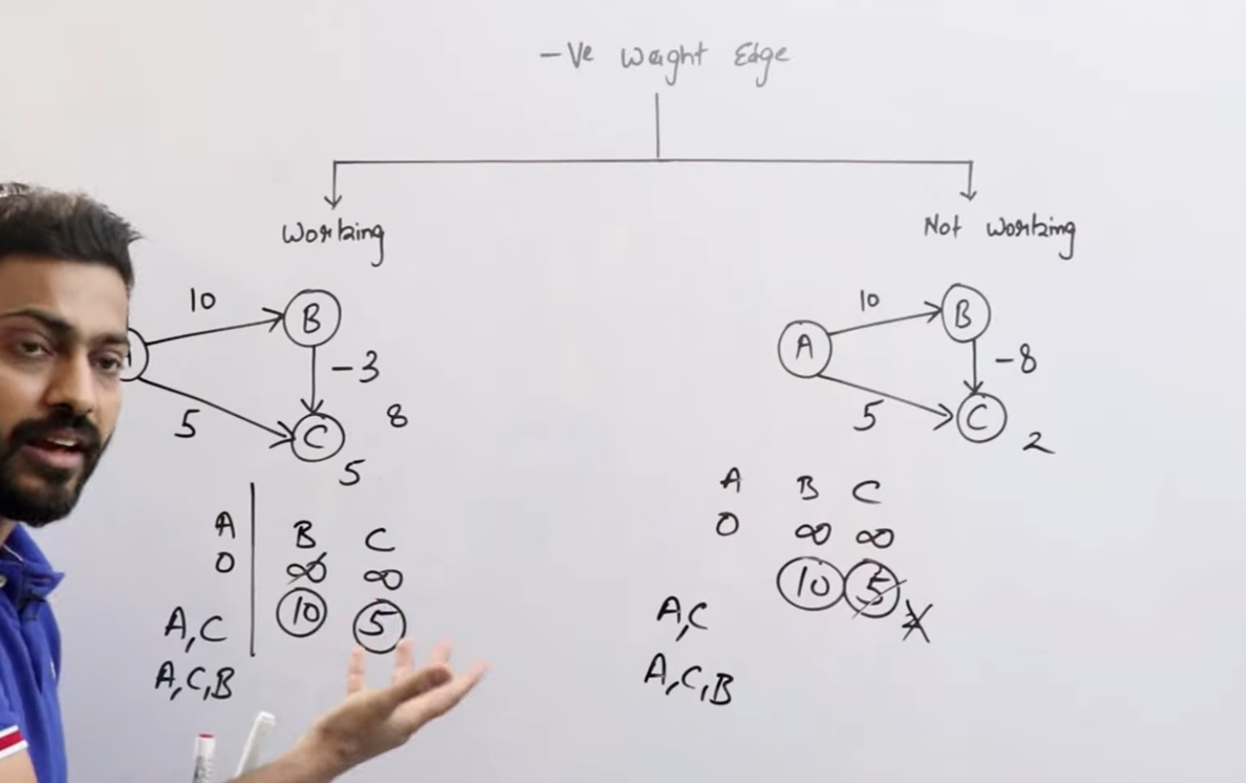
The major setback of Dijkstra’s algorithm is that it cannot handle negative edge weights — if the graph has any, the results may be incorrect.

Slide 37
Bellman Ford Algorithm
The Bellman–Ford algorithm is a shortest path algorithm that computes the shortest distances from a single source vertex to all other vertices in a weighted graph. Unlike Dijkstra’s algorithm, it can handle negative weight edges, but not negative weight cycles.
Key Points
Works on directed, weighted graphs (can be adapted to undirected by treating edges both ways).
Handles negative edge weights.
Detects negative weight cycles.
Time complexity: O(V·E) (V = number of vertices, E = number of edges).
Slower than Dijkstra’s but more versatile.
Algorithm Steps
Initialization:
Set distance to source = 0.
Set distance to all other vertices = ∞.
Relaxation (repeat V−1 times):
For every edge (u, v) with weight w:
If distance[u] + w < distance[v]:
Update distance[v] = distance[u] + w.
Negative Cycle Detection:
Run one more relaxation.
If any distance gets updated, it means a negative weight cycle exists.

Slide 38
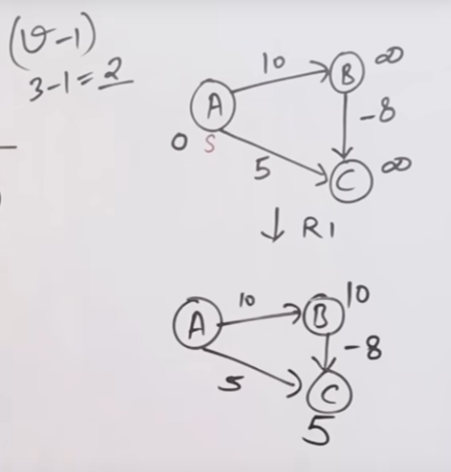
IMPORTANT NOTE: In Bellman Ford you have to relax every edge V – 1 times
Eg: here there are 3 vertices A, B, C so we have to do relaxation 3 – 1 = 2 times
(1st Relaxation)

Slide 39

Although all edges are relaxed but Bellman Ford will do relaxation 1 more time to detect negative edge cycles
After finishing V−1 relaxations, we perform one more iteration:
If any edge can still be relaxed → that means there’s a negative cycle.
Otherwise → no negative cycle exists.

Slide 40

There is no change in the graph so it’s clear that there is no negative edge cycles

Slide 41



Example 2: At first we will relax all edges V – 1 times:
Now if we try to relax it one more time to check negative edges then:
Here, the negative edge cycle is detected in this relaxation step so Bellman ford stops further execution.

Slide 42

Bellman Ford Pseudocode:
Time and Space Complexity Analysis:
Aspect | Complexity
Time (V−1 relaxations) | O(V·E)
Time (with negative cycle check) | O(V·E)
Space (distance + edges) | O(V + E)

Slide 43
Dynamic Programming
What is Dynamic Programming?
Dynamic Programming (DP) is a problem-solving technique used to solve problems that can be broken into overlapping subproblems and exhibit optimal substructure.
Overlapping Subproblems: The problem can be broken down into smaller subproblems which are solved multiple times.
Optimal Substructure: The optimal solution of the main problem can be constructed from optimal solutions of subproblems.
DP is essentially memoization or tabulation to avoid recomputation.
Key Idea
Instead of solving the same subproblem repeatedly (like in recursion), DP stores the results of subproblems and reuses them.

Slide 44



Steps to Solve a DP Problem
Define the subproblem clearly.
Example: For Fibonacci, F(n) = F(n-1) + F(n-2)
Formulate a recurrence relation.
Recursively express the solution in terms of smaller subproblems.
Decide a DP approach:
Top-Down (Memoization): Recursive + cache results.
Bottom-Up (Tabulation): Iterative, fill a table from smaller subproblems.
Compute the final solution using stored results.
Example: Fibonacci Numbers
Recurrence:
$$F\left(n\right)=F\left(n−1\right)+F\left(n−2\right), F\left(0\right)=0,F\left(1\right)=1$$
Top-Down (Memoization): Bottom-Up (Tabulation):
Advantages of DP
Reduces exponential time recursive solutions to polynomial time.
Efficient for problems with overlapping subproblems.
Common DP Problems
Fibonacci sequence
Knapsack problem (0/1, unbounded)
Longest Common Subsequence (LCS)
Minimum Coin Change
Matrix Chain Multiplication
Shortest Path (Bellman-Ford can also be seen as DP)

Slide 45
Why 0/1 Knapsack failed using Greedy approach ?
The 0/1 Knapsack problem cannot be solved correctly using a Greedy approach because the greedy choice does not always lead to the optimal solution.
In Fractional Knapsack, you can take fractions of an item, so choosing based on the highest value/weight ratio always works.
But in 0/1 Knapsack, you can only take the whole item or leave it.
A greedy choice (like taking the item with the highest value/weight ratio first) can block you from achieving the true maximum value.
Example:
Knapsack capacity = 50 Greedy Approach (by value/weight ratio):
Pick item 1 (10, 60) → total = 60, weight = 10
Pick item 2 (20, 100) → total = 160, weight = 30
Remaining capacity = 20, but item 3 needs 30 → cannot take it.
Greedy Total = 160
Item | Weight | Value | Value/Weight
1 | 10 | 60 | 6.0
2 | 20 | 100 | 5.0
3 | 30 | 120 | 4.0

Slide 46

0/1 Knapsack Problem using Dynamic Programming
Problem
Capacity $W=50$
Items:
Weight = 10, Value = 60
Weight = 20, Value = 100
Weight = 30, Value = 120
We have n items, each with a weight w[i] and value v[i].
Knapsack capacity = W.
Goal: Maximize value without exceeding capacity.
Constraint: Each item can be chosen at most once (0 or 1).
DP Idea
Define dp[i][w] = maximum value achievable using first i items with capacity w.

Slide 47



Step 1: Define DP
$$dp\left[i\right]\left[w\right]=\text{maximum} \text{value} \text{using} \text{first} \text{i} \text{items} \text{with} \text{capacity} \text{w}$$
Base case: $dp\left[0\right]\left[w\right]=0( 0 items →0 value)$.

Slide 48



Step 3: Final Result
$$dp\left[3\right]\left[50\right]=220$$
Optimal value = 220 (take items 2 and 3).

Slide 49



Travelling Salesman Problem with Greedy and Brute Force Approach
with greedy we get total cost = 55
with brute force we get total cost = 35
All possible tours starting & ending at 1 (3! = 6):
1 → 2 → 3 → 4 → 1 cost = 1→2 (10) + 2→3 (25) + 3→4 (5) + 4→1 (15) = 55
1 → 2 → 4 → 3 → 1 cost = 10 + 2→4 (10) + 4→3 (20) + 3→1 (15) = 55
1 → 3 → 2 → 4 → 1 cost = 15 + 3→2 (30) + 2→4 (10) + 4→1 (15) = 70
1 → 3 → 4 → 2 → 1 cost = 15 + 3→4 (5) + 4→2 (10) + 2→1 (5) = 35 ← minimum
1 → 4 → 2 → 3 → 1 cost = 20 + 4→2 (10) + 2→3 (25) + 3→1 (15) = 70
1 → 4 → 3 → 2 → 1 cost = 20 + 4→3 (20) + 3→2 (30) + 2→1 (5) = 75
Answer (brute-force): Minimum tour is 1 → 3 → 4 → 2 → 1 with total cost 35.
Brute Force: O(n!)
Greedy: O(n²)

Slide 50

Travelling Salesman Problem with Dynamic Programming

Slide 51


Sum of Subset Problem with Dynamic Programming
Problem Statement: Given a set of integers and a target sum S, determine whether there exists a subset of the given set whose sum equals S.
Brute Force Approach
Try all 2ⁿ subsets and check if any has sum S.
Time Complexity: O(2ⁿ) (exponential).
Not feasible for large n.
Dynamic Programming Approach
We define:
dp[i][j] = True if using the first i elements, a subset sum of j can be formed;
else False.
Recurrence Relation:

Slide 52
Algorithm (Bottom-Up DP)
Initialize dp[n+1][S+1].
Set dp[i][0] = True for all i (sum 0 possible by empty subset).
Fill the table using recurrence.
Answer = dp[n][S].
Example
Set = {3, 34, 4, 12, 5, 2}, S = 9
Using DP, we find: dp[6][9] = True → Subset {4, 5} gives sum 9.
Complexity Analysis
Time Complexity: O(n.S)
Space Complexity: O(n.S) (can be optimized to O(S)).

Slide 53

Matrix Chain Multiplication with Dynamic Programming

Slide 54


Slide 55


Slide 56

Longest Common Subsequence using a recursive approach
Concept:
Given two strings $X$and $Y$, LCS(X, Y) = the length of the longest subsequence common to both.
Recursive Idea
We compare the last characters of the two strings:
If they match, we include that character in LCS and move diagonally backward (i.e., shrink both strings).
If they don’t match, we explore both options:
Exclude the last character of X
Exclude the last character of Y
Take the maximum of both.

Slide 57



Recursive Formula
Example
X = "AGGTAB"
Y = "GXTXAYB"
Recursive Code
Step-by-step (brief trace)
Compare B and B → match ✅ → 1 + LCS("AGGTA", "GXTXAY")
Compare A and Y → no match → max(LCS("AGGT", "GXTXAY"), LCS("AGGTA", "GXTXA"))
Continue recursively until base case reached.
At the end → LCS = “GTAB”, length = 4

Slide 58


Slide 59
Multistage Graph
Definition
A multistage graph is a directed graph where nodes are divided into multiple stages (levels).
Edges only go from one stage to the next stage (never backward or skipping stages).
Goal: Find the shortest (or longest) path from the source (stage 1) to the sink (last stage).
Characteristics
Graph is acyclic (no cycles).
Vertices are grouped into k stages (Stage 1 → Stage 2 → … → Stage k).
Source lies in Stage 1, destination (sink) lies in Stage k.
Used to model problems like project planning, job scheduling, and resource allocation.

Slide 60


Example:
Stages: S1 = {1} (source), S2 = {2,3,4}, S3 = {5,6,7}, S4 = {8} (destination)
Edges (weight):
From 1: 1→2 (1), 1→3 (2), 1→4 (7)
From 2: 2→5 (4), 2→6 (8)
From 3: 3→5 (9), 3→6 (5), 3→7 (17)
From 4: 4→7 (2)
From 5: 5→8 (20)
From 6: 6→8 (15)
From 7: 7→8 (2)
1) We want the min-cost path from 1 → 8. Use:
and cost(8)=0.
2) Stage S4 (base)
cost(8) = 0.

Slide 61





Slide 62
7) Summary (DP table style)
Node : chosen next : cost
8 : — : 0
5 : 8 : 20
6 : 8 : 15
7 : 8 : 2
2 : 6 : 23
3 : 7 : 19
4 : 7 : 4
1 : 4 (source) : 11 <-- final answer
8) Complexity
We computed each edge once (processing stages forward/backward), so Time = O(E).
Space = O(V) to store cost and successor arrays.

Slide 63

Floyd Warshall Algorithm (All-Pair Shortest Path)
Purpose
It finds all-pairs shortest paths in a weighted directed graph.
Works even with negative edge weights (but not with negative cycles).
Idea
We iteratively try to improve the distance between every pair of vertices (i, j) by allowing intermediate vertices.
Let dist[i][j] = shortest distance from i to j.
Initially, dist[i][j] is the direct edge weight (or ∞ if no edge).
Then, for each vertex k, we update:
This means: shortest path from i to j is either:
the existing direct path, OR
the path going through vertex k.

Slide 64






Step 2: Distance Matrix D1 (can consider via 1 if shortest)
Example: Step 1: Distance Matrix D0
Step 4: Distance Matrix D4 (Final Result)
Step 4: Distance Matrix D3 (can consider via 3 if shortest)
Step 3: Distance Matrix D2 (can consider via 2 if shortest)

Slide 65

Analysis of Floyd Warshall Algorithm (All-Pair Shortest Path)
Pseudocode:
FloydWarshall(dist[][]):
for k = 1 to n:
for i = 1 to n:
for j = 1 to n:
if dist[i][k] + dist[k][j] < dist[i][j]:
dist[i][j] = dist[i][k] + dist[k][j]
Complexity
Time: O(n³) (3 nested loops)
Space: O(n²) (distance matrix)

Slide 66
Thank You
© Gate Smashers, ChatGPT & Abdul Bari
Created By – Tejas Tp (Legend)

